Slide 1

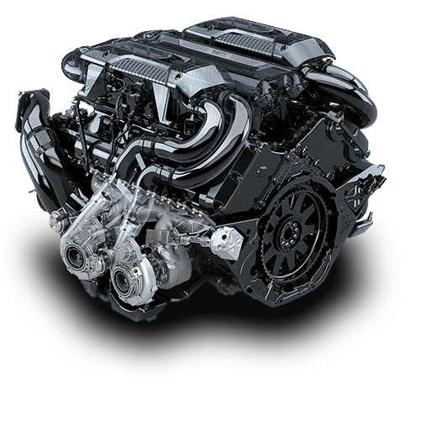
Design of Experiment to Study The Effect of Mixing Nano-additive With Engine Oil on The Heat Transfer Performance
Team
8
- Group Names:
Ahmed Alramadan 201203367
Mohammed Alhejji 201301929
Abdullah Alkhalifa 201200254
Muhanna Almuhanna 201202294
Hussain Alghumgham 201400042
- Advisor/Co-Advisor:
Dr. Essam Jasim
Dr. Panagiotis Sphicas

Slide 2
Outline
Objectives
Project Background
Design Constrains
Design Specification
Conceptual Design
Experimental Setup
Results and Discussion
Conclusion

Slide 3
Project Objective
To design and implement a cross flow water-air radiator and oil-coolant for normal spark ignition (SI) engine.
To investigate the effect of using Nano-additive with oil engine and coolant on the engine performance.
To study the enhancement of the rate of heat transfer in the engine oil and radiator when Nano-particles is employed.

Slide 4
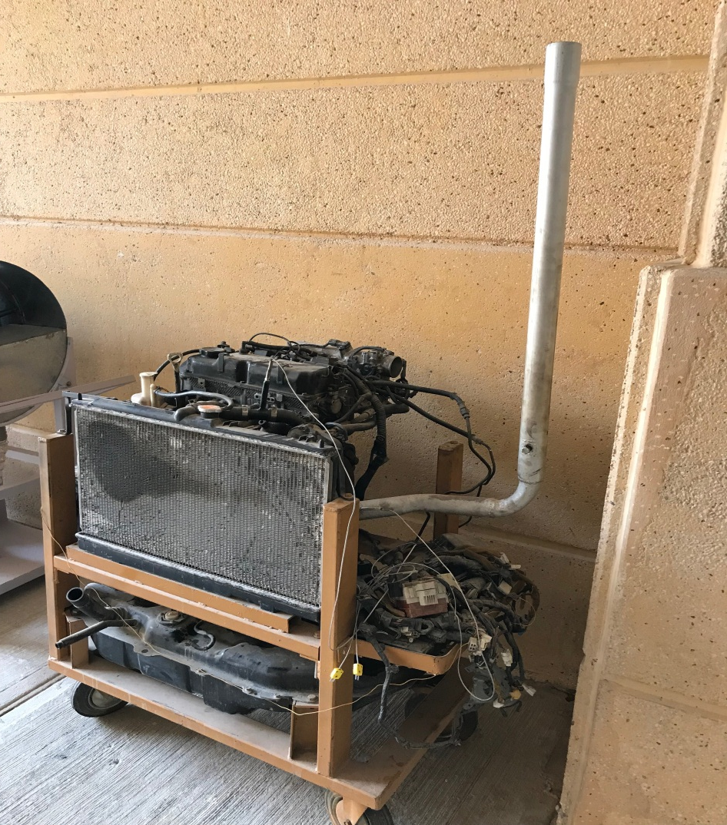
Project Background
  Why we select this project?
  Life span
  Cost reduction
  Environment protection
  Internal Combustion Engine

Slide 5
Design Constrains
Safety and Environment
  Outdoor working condition
  Project safety index (Mask, Safety Goggles, Gloves and Lab Coat)
Weight and Size
  Difficulties in the transportation
Heat Measurement
  Tools
Nano-particles Material
  Copper

Slide 6
design specification
Mitsubishi Engine Specification
Category | Description
Weight | 62 Kg
Height | 1 m
Width | 1 m
Capacity | 1.5 liter / 1499 cc
Cylinder | 4
Type of Engine | 4 Stroke, Petrol

Slide 7
design specification
Mitsubishi Radiator Dimensions
Category | Description
Weight | 4.830 Kg
Thickness | 16 mm
Width | 685 mm
Height | 375 mm

Slide 8
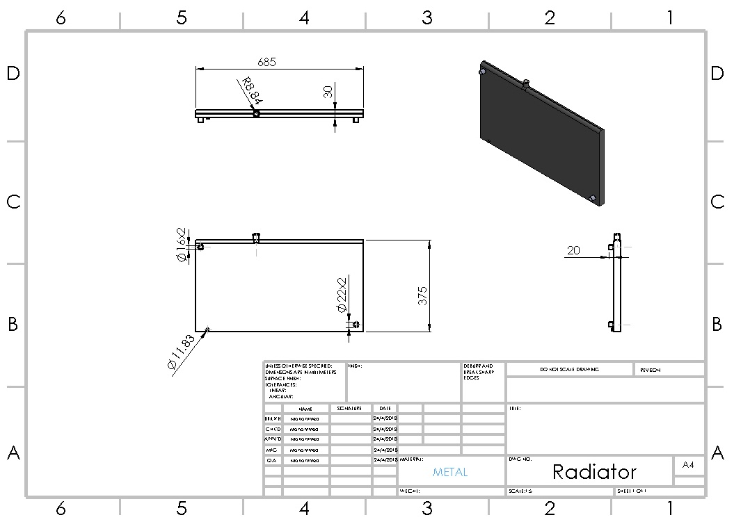
Conceptual Design

Slide 9
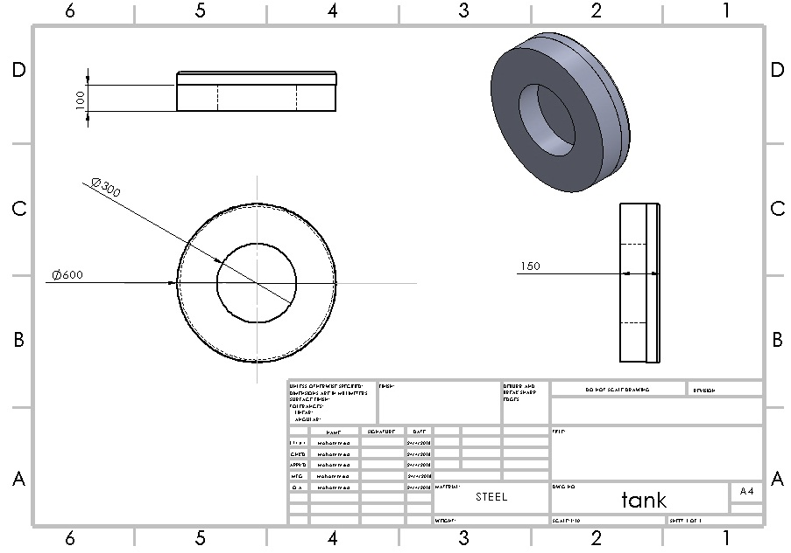
Conceptual Design

Slide 10
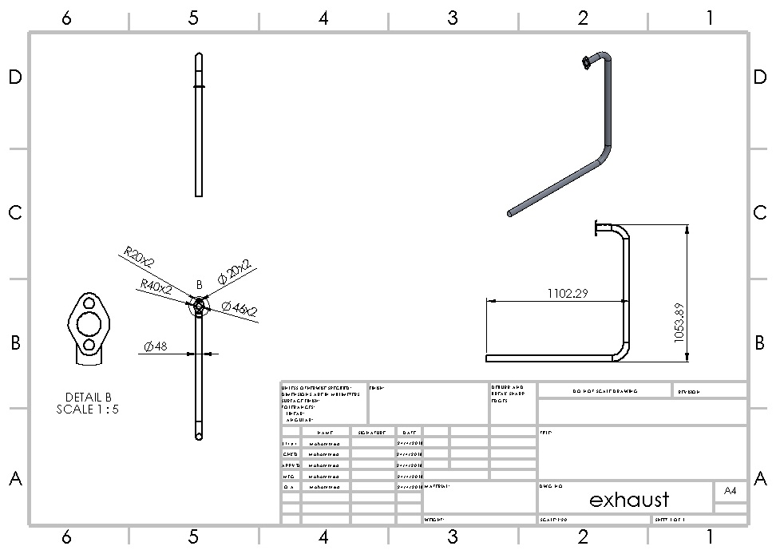
Conceptual Design

Slide 11
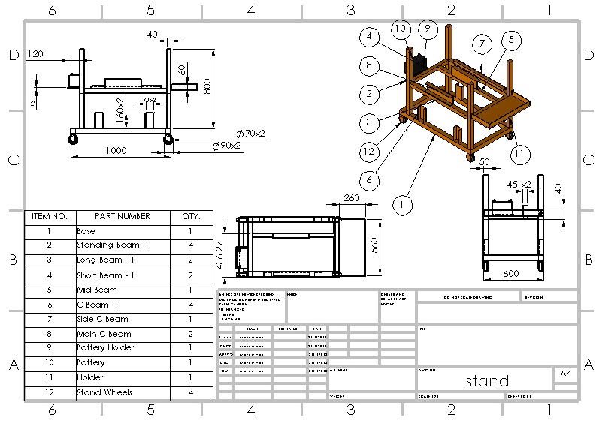
Conceptual Design

Slide 12
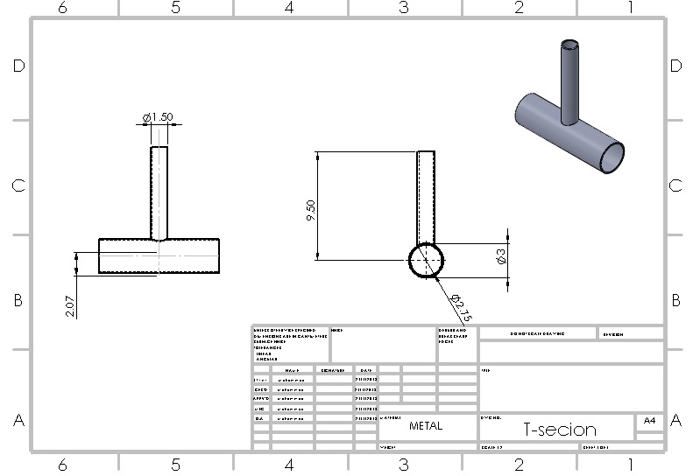
Conceptual Design

Slide 13
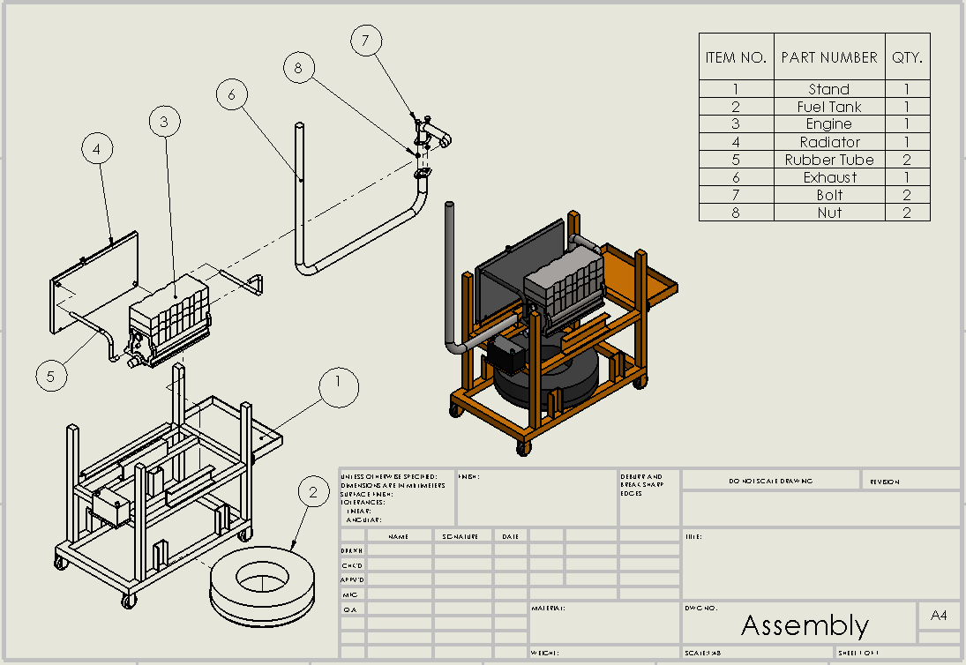
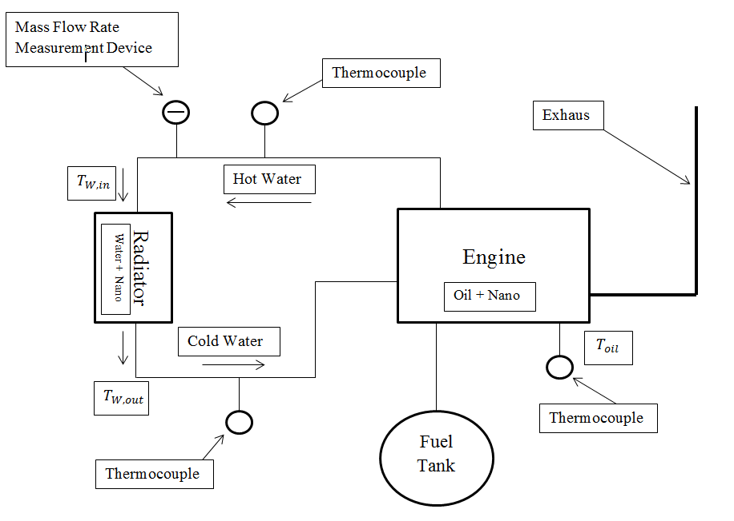
Conceptual Design
CAD Drawing of The System Block Diagram of The System

Slide 14
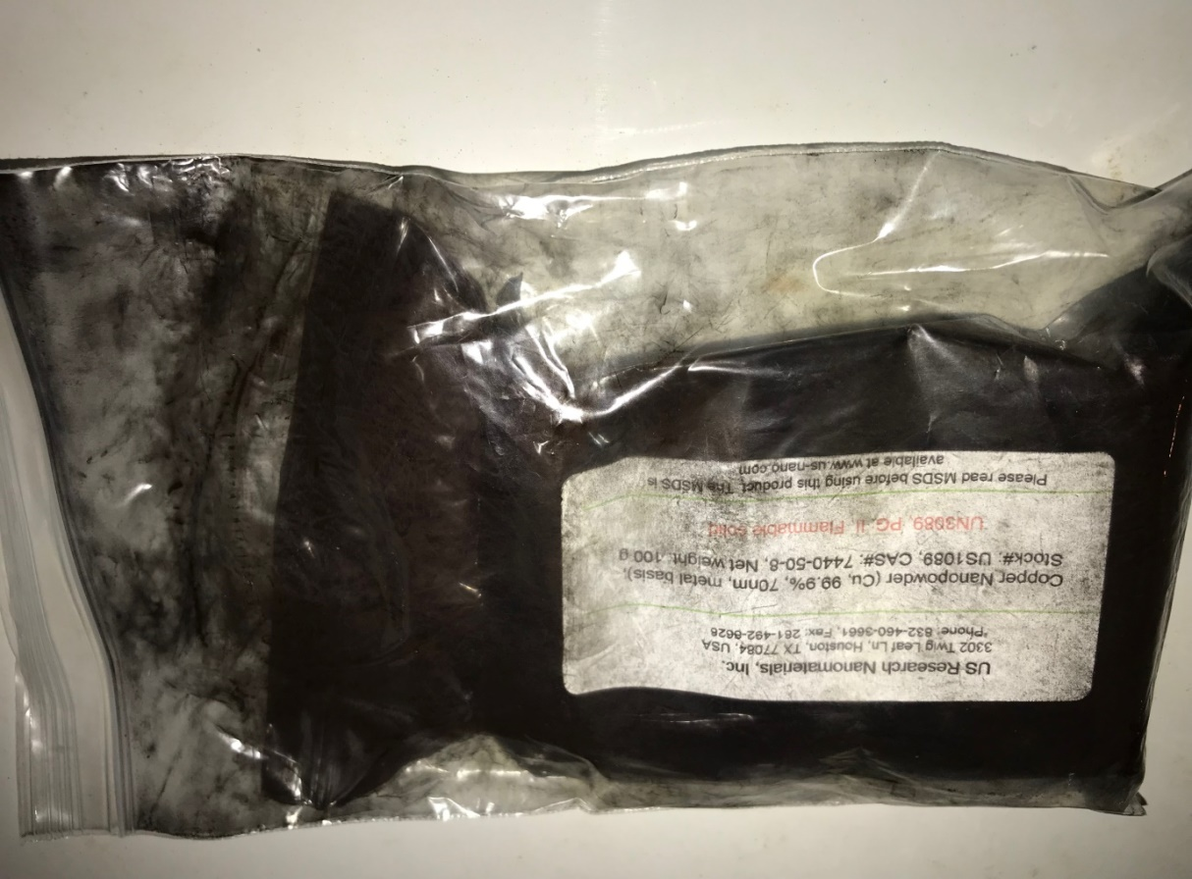
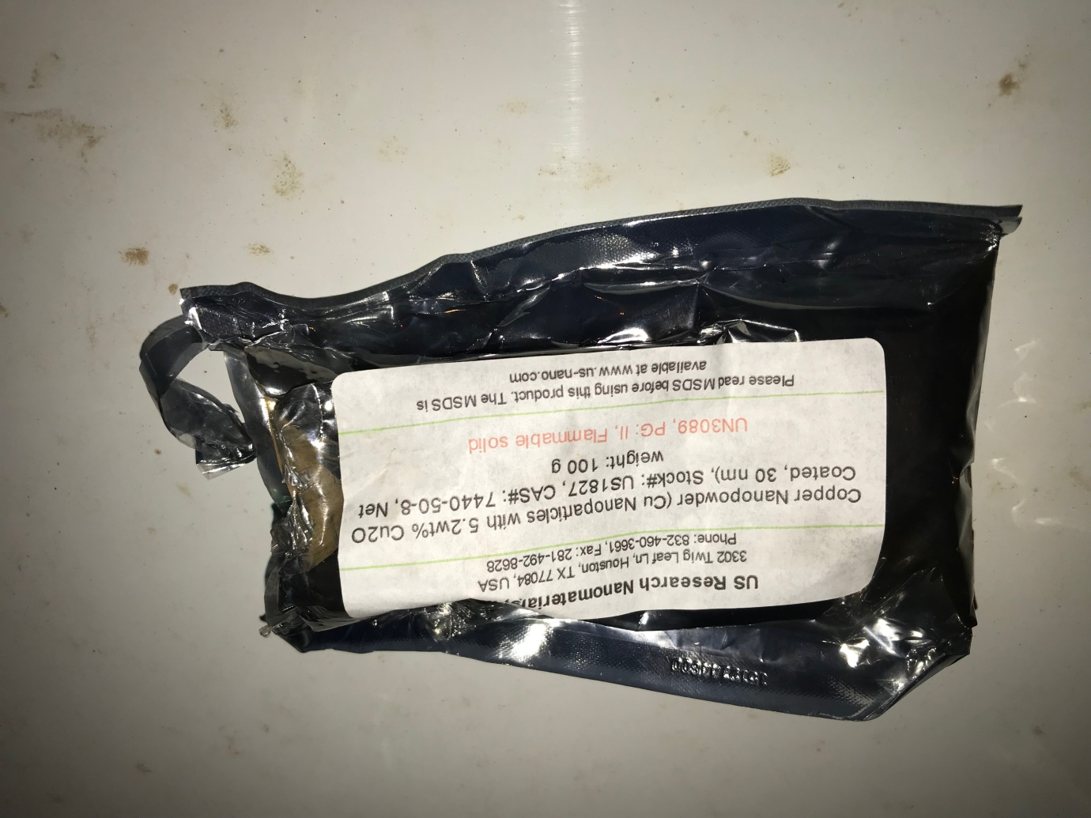
Experimental Setup
Nano-particles
Copper Nano-powder ( 70nm)
Copper Nano-powder ( 30nm)

Slide 15

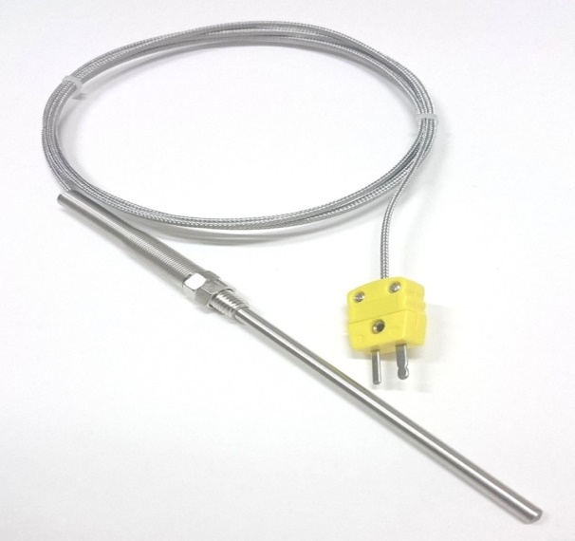
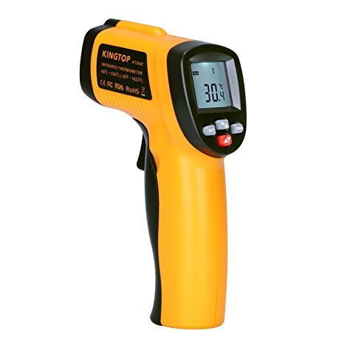
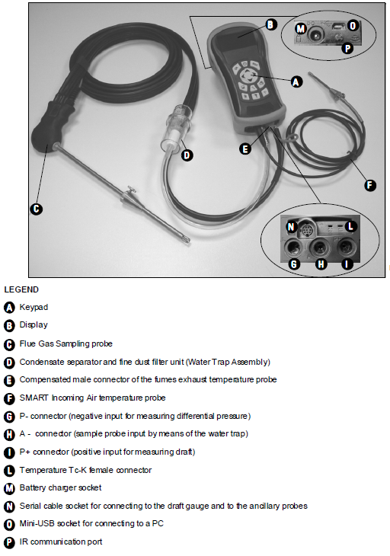
Experimental Setup
Temperature Measurement Devices
Digital Thermocouple
Display
Thermocouple
Laser Gun
BTU-900

Slide 16
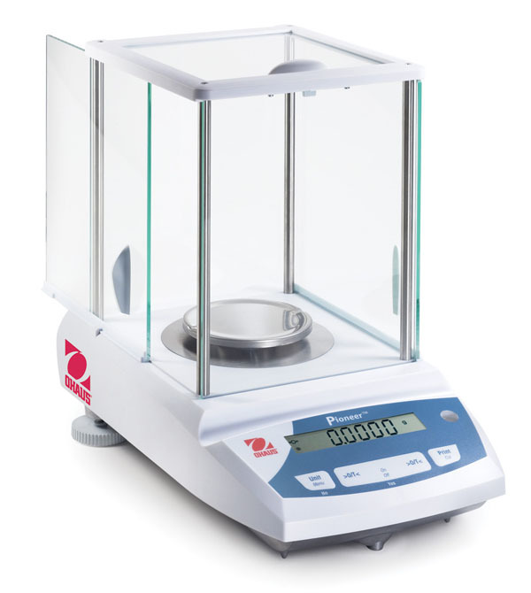
Experimental Setup
Other Components
Electronic Scale

Slide 17
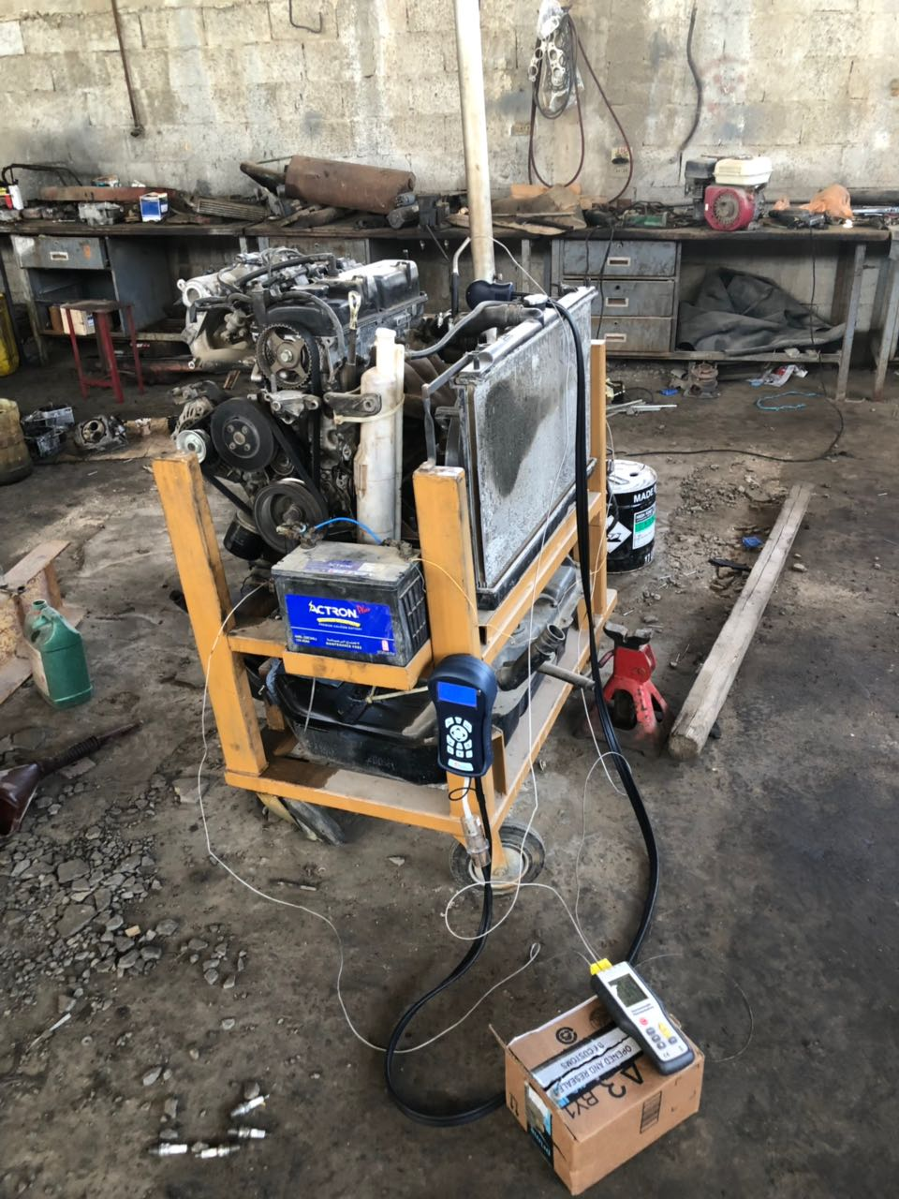
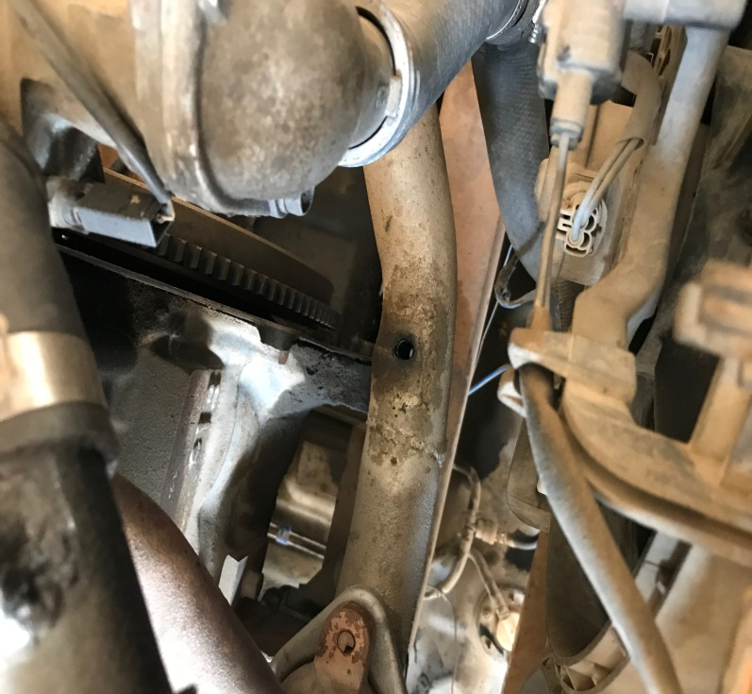
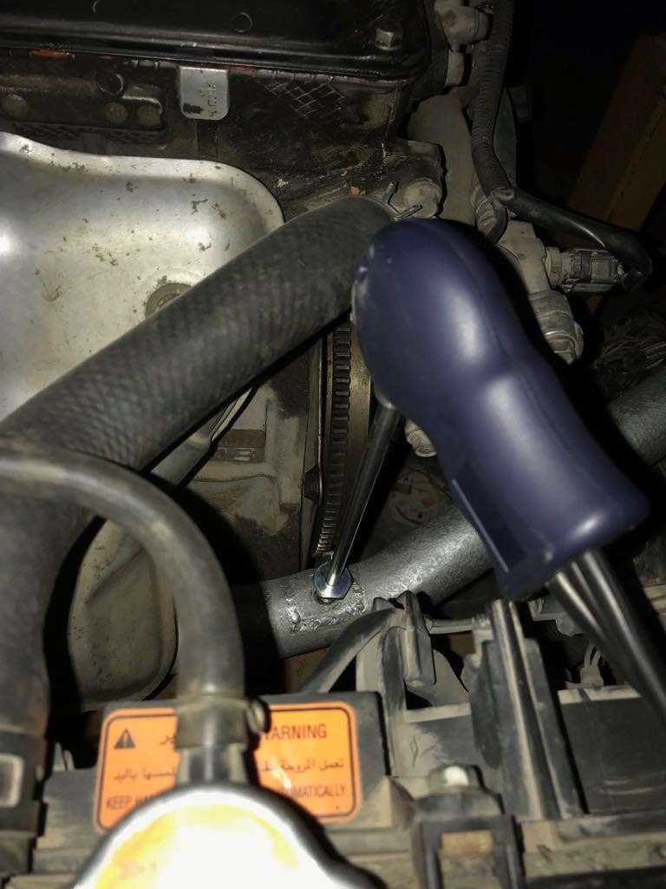
Experimental Setup
Engine Setup
Exhaust hole
BTU-900 Installation

Slide 18
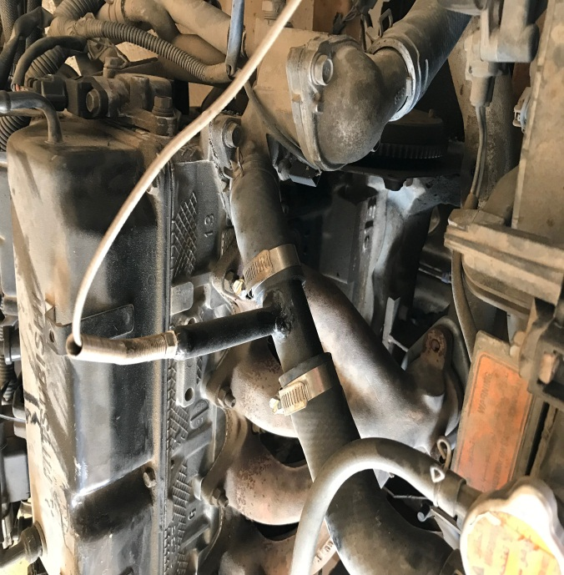
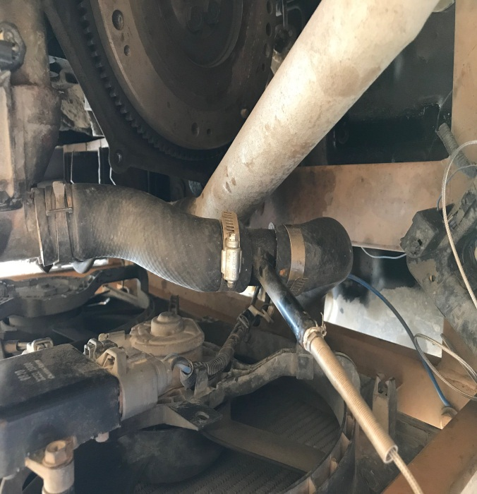
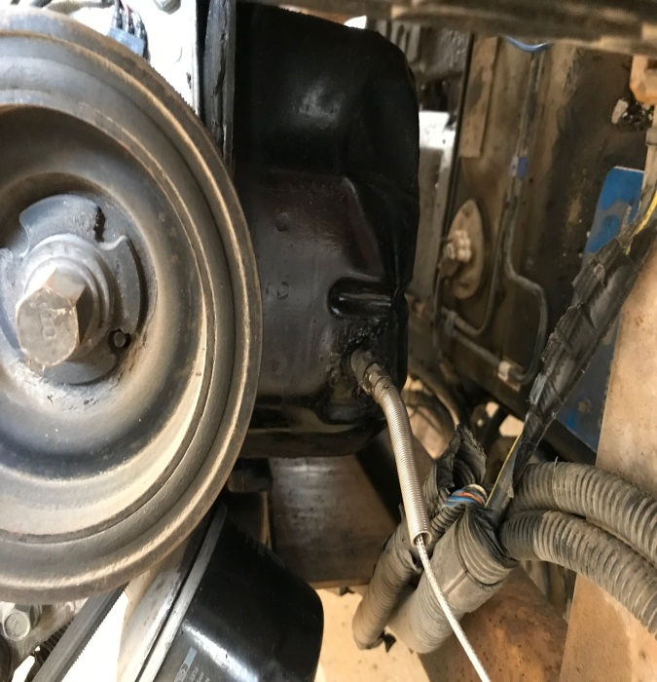
Experimental Setup
Water into Radiator
Water out of Radiator
Oil Engine

Slide 19
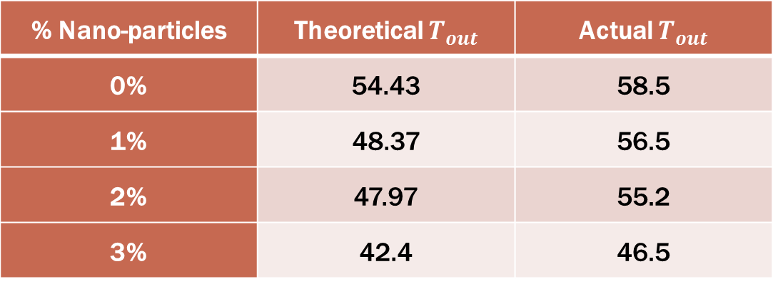
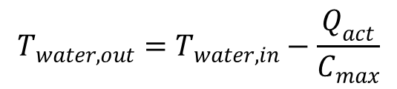
Results and Discussion
Calculation
Radiator:
$$T_{water, out}=T_{water, in}−\frac{Q_{act}}{C_{max}}$$
% Nano-particles | Theoretical $T_{out}$ | Actual $T_{out}$
0% | 54.43 | 58.5
1% | 48.37 | 56.5
2% | 47.97 | 55.2
3% | 42.4 | 46.5

Slide 20
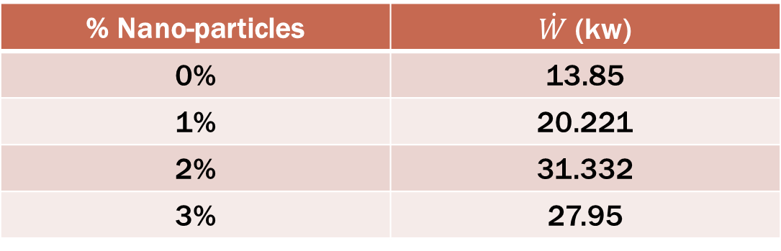
Results and Discussion
Calculation
Engine
$$0={\dot{Q}}_{rad}−\dot{W}+{\dot{Q}}_{act}+{\dot{m}}_{fuel} h_{fuel}+{\dot{m}}_{air} h_{air}−{\dot{m}}_{exhaust} h_{exhaust}$$
$$\dot{W}={\dot{Q}}_{rad}+{\dot{Q}}_{act}+{\dot{m}}_{fuel} h_{fuel}+{\dot{m}}_{air} h_{air}−{\dot{m}}_{exhaust} h_{exhaust}$$
% Nano-particles | $\dot{W}$ (kw)
0% | 13.85
1% | 20.221
2% | 31.332
3% | 27.95

Slide 21
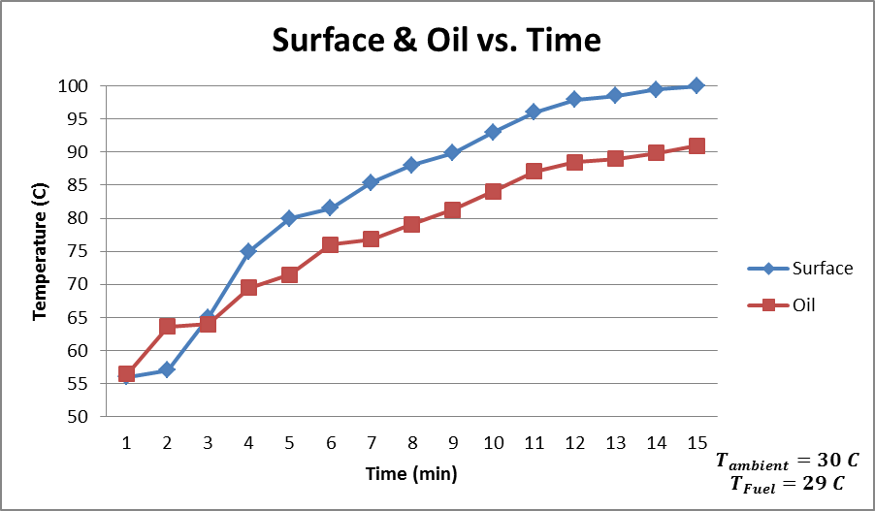
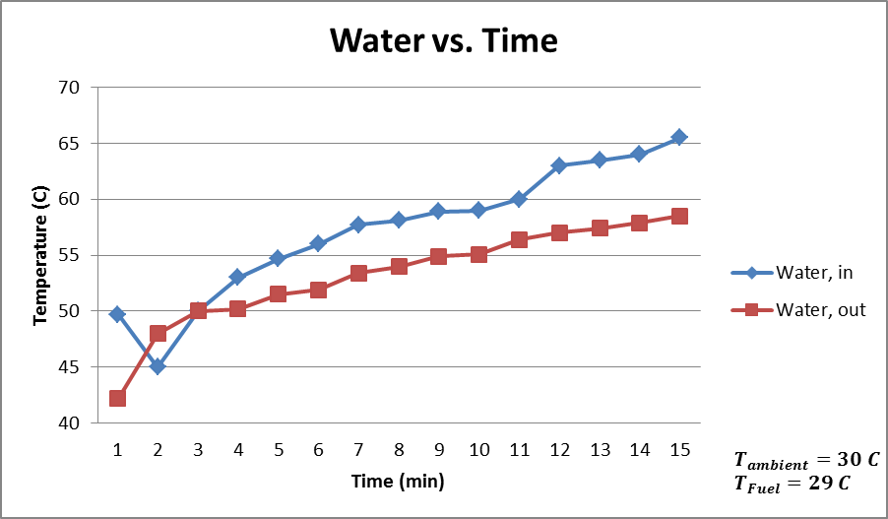
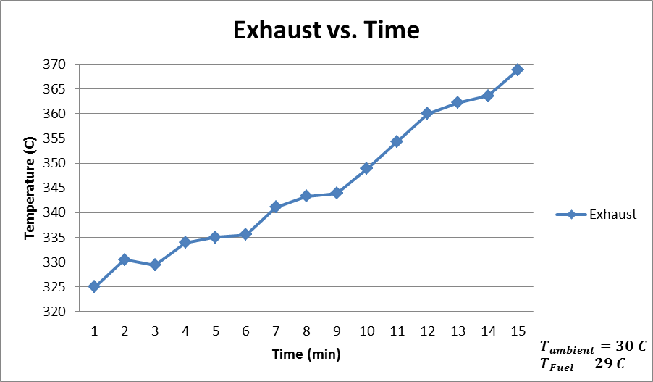
Results and Discussion
0% Nano-particles (30nm)

Slide 22
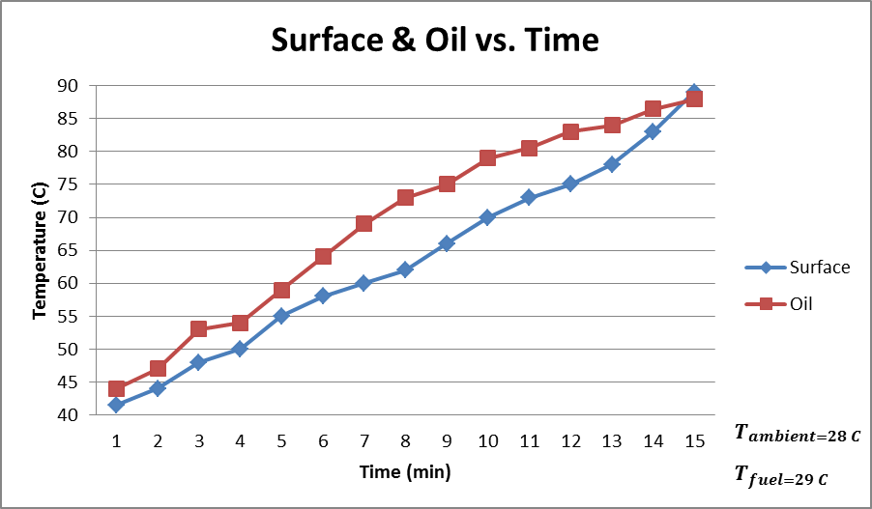
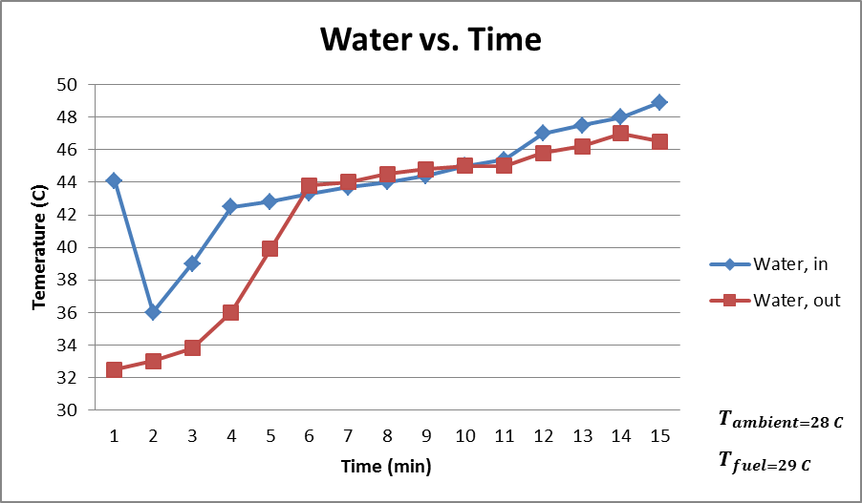
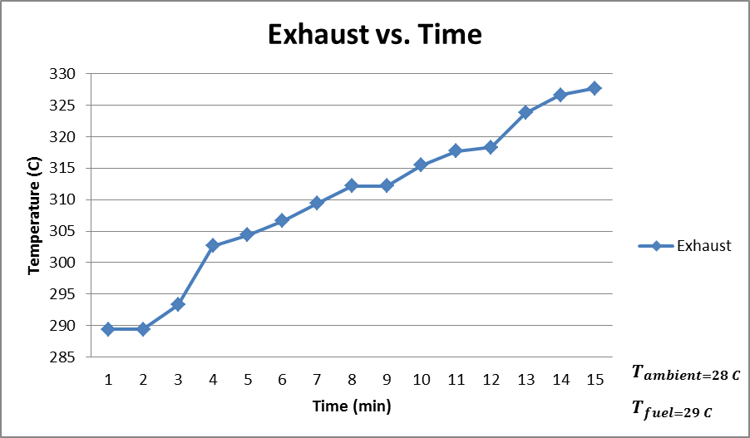
Results and Discussion
1% Nano-particles (30nm)

Slide 23
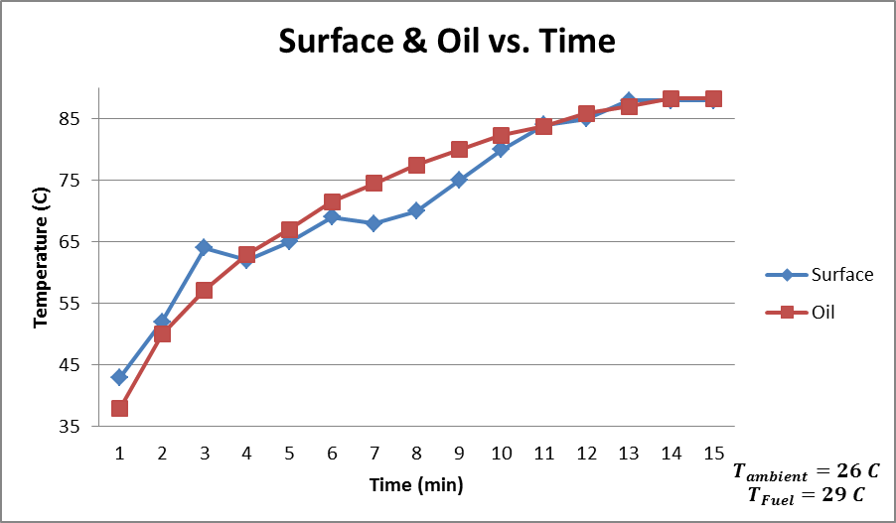
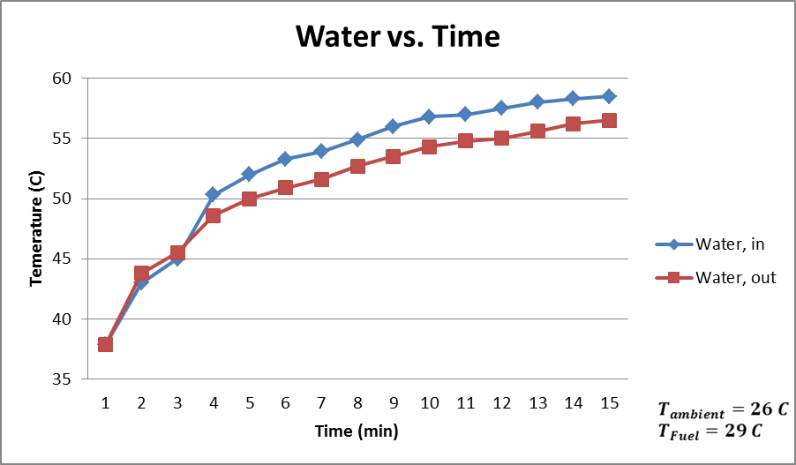
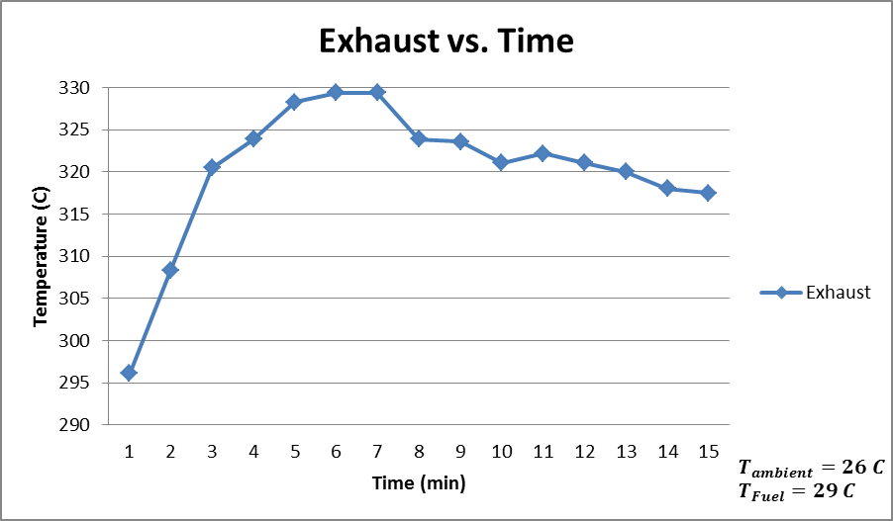
Results and Discussion
2% Nano-particles (30nm)

Slide 24
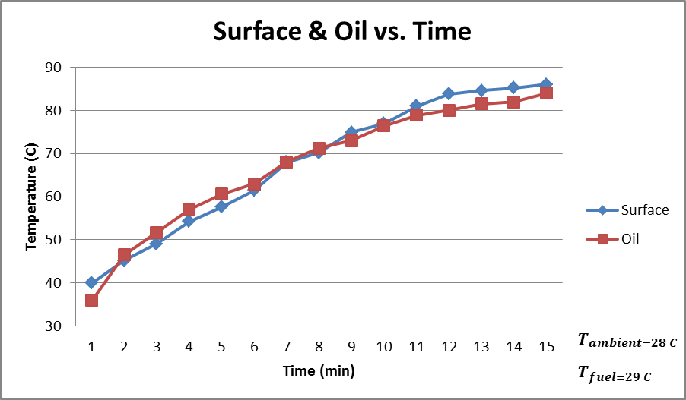
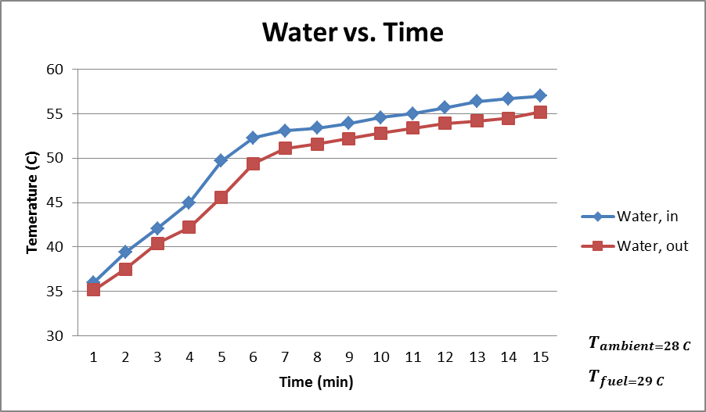
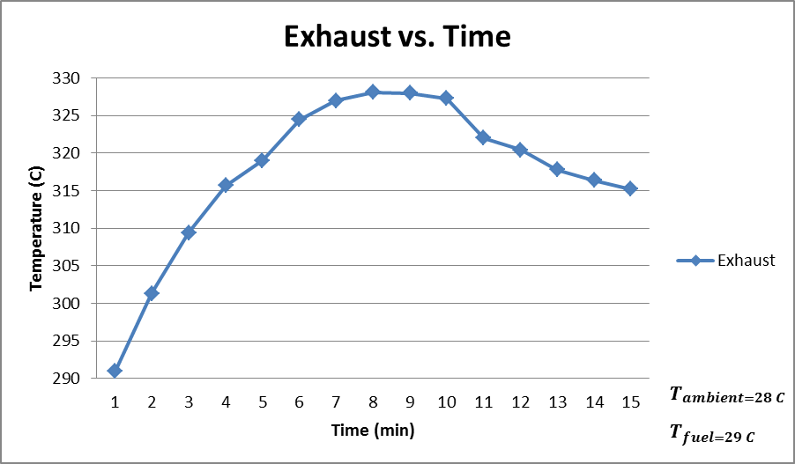
Results and Discussion
3% Nano-particles (30nm)

Slide 25
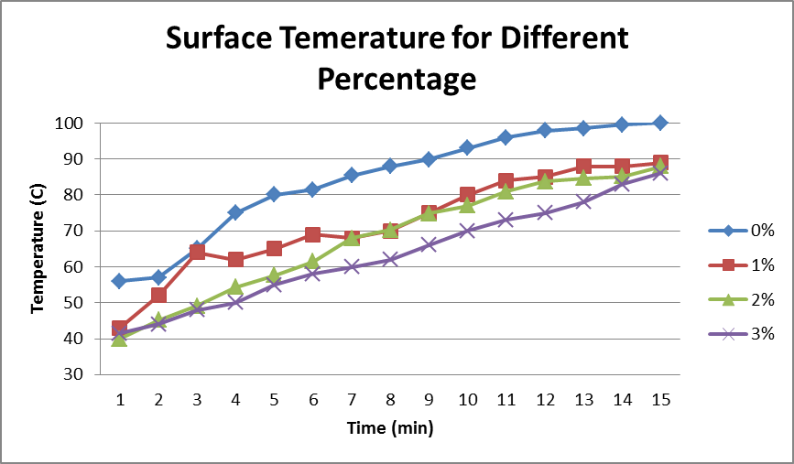
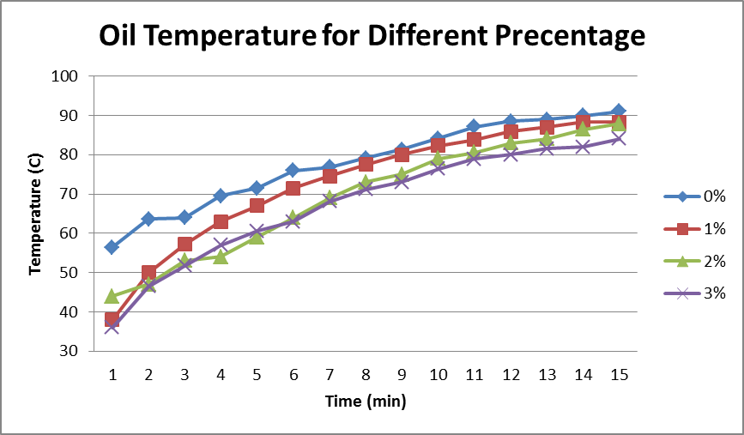
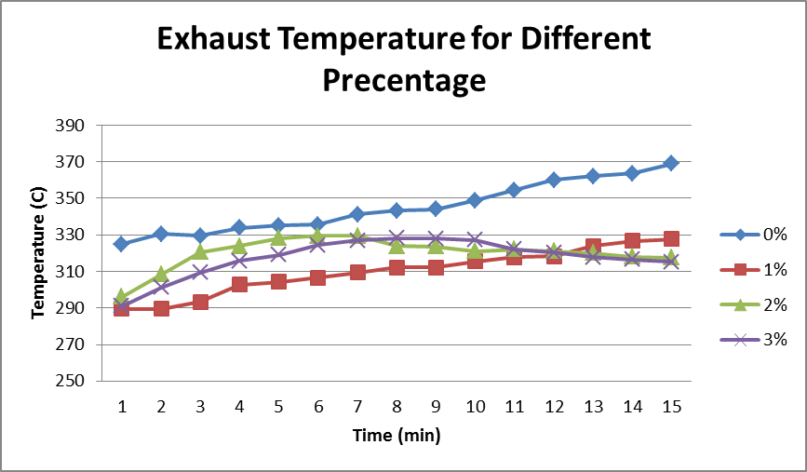
Results and Discussion
Compression Between 0%, 1%, 2%, 3%

Slide 26
Conclusion
Optimizing Heat Transfer Performance
Reduction of temperature
Failure of bearing rod At 4% (30nm)

Slide 27
Thank You

