Slide 1

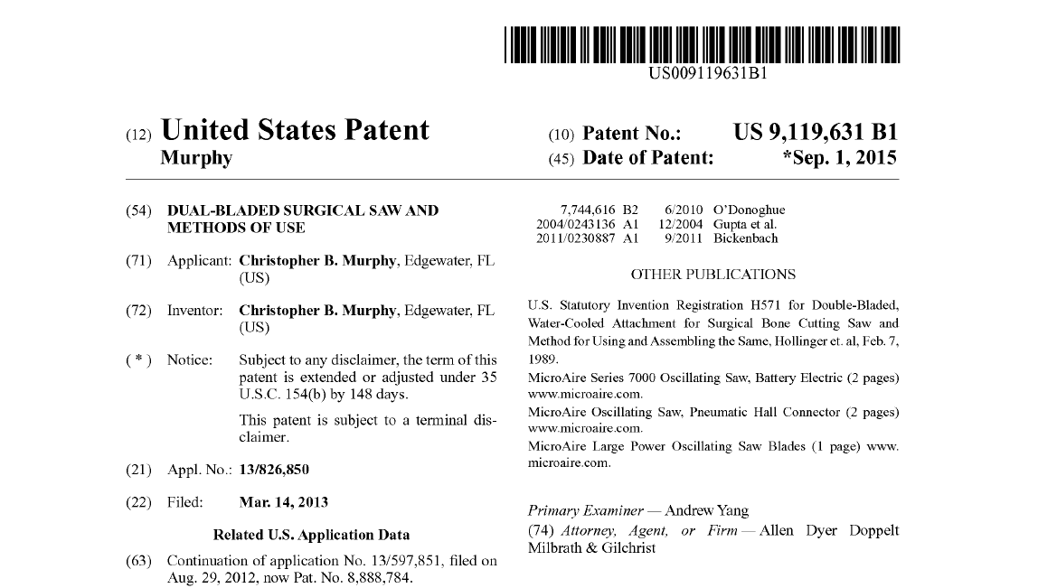
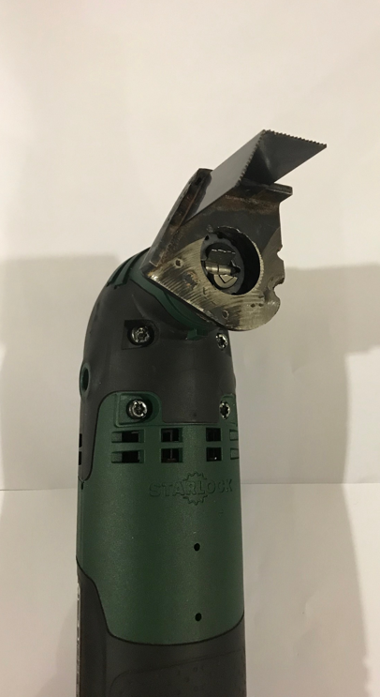
Design & Manufacture a Dual-Bladed Surgical Saw
ASSE 4311: Learning Outcomes Assessment III
Senior Design Project
Team# 1
Ibrahim Althowiqeb | 201301876
Omar Alzahrani | 201203335
Ahmad Aldakhiel | 201300056
Yazeed Almansour | 201300630
Abdullah Alotaibi | 201302697
Derived from the United status patent did by Dr. Christopher Murphy
Project Advisor: Dr. Jamal Nayfeh, Co-advisor: Dr. Panos

Slide 2
OUTLINE
ASSE 4311: Learning Outcomes Assessment III - SDP
Project Introduction.
Objectives.
Project Relevance
Design Constrains.
Engineering Standards.
Conceptual Design.
Testing & Results
Conclusion & Future Recommendations

Slide 3
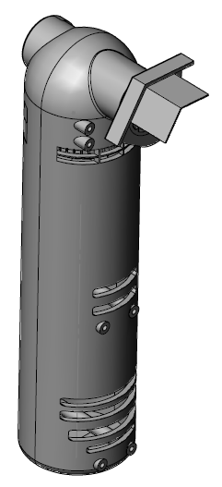
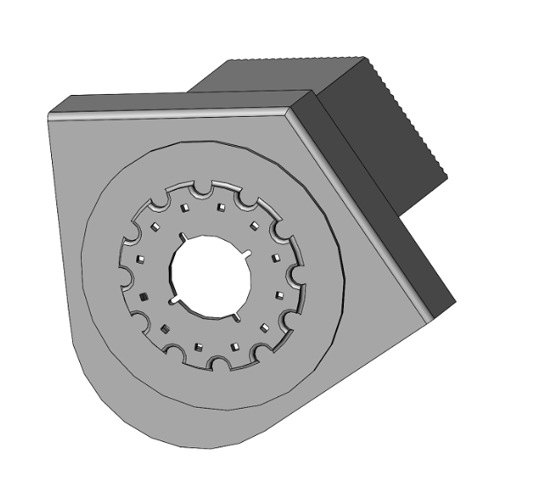
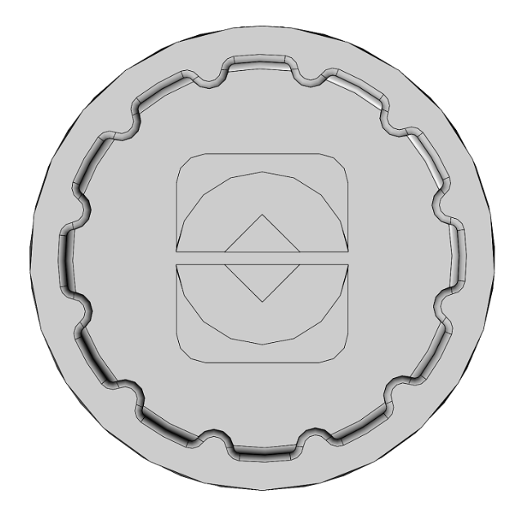
Project Introduction
ASSE 4311: Learning Outcomes Assessment III - SDP
Total Joint Arthroplasty (TJA).
An oscillating saw for the resection of bones.
Dual-bladed surgical saw cuts with coincide angles.
Designing a blade assembly with a star lock adapter.
Applications:
  Dual-bladed surgical saw ready to use by the podiatrist for performing orthopedic surgeries.
  Dual-bladed surgical saw can be used to cut different locations in the human body.

Slide 4
Objectives
ASSE 4311: Learning Outcomes Assessment III - SDP
Design a blade assembly with dual blades to cut two different planes simultaneously.
Simplifying the surgical cutting procedure by reducing sequential cuts.
Reduce surgery time.
Accurate and precise cutting action with no further need for using a cutting guide.

Slide 5
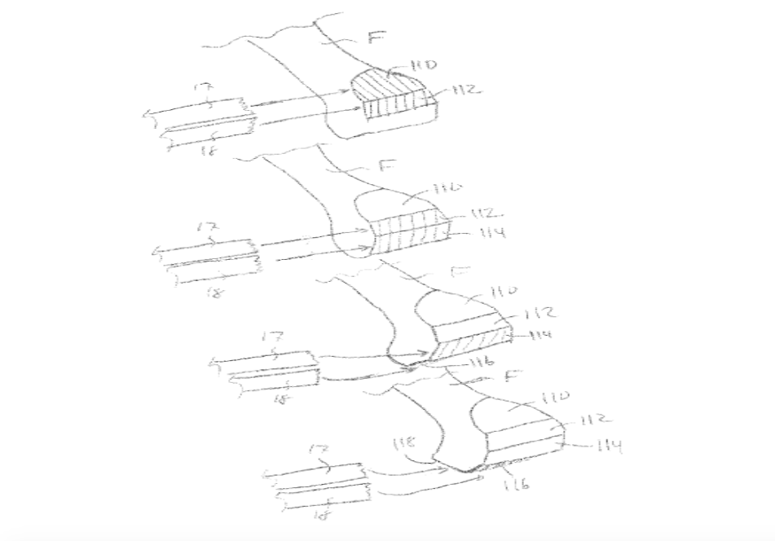
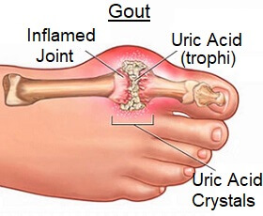
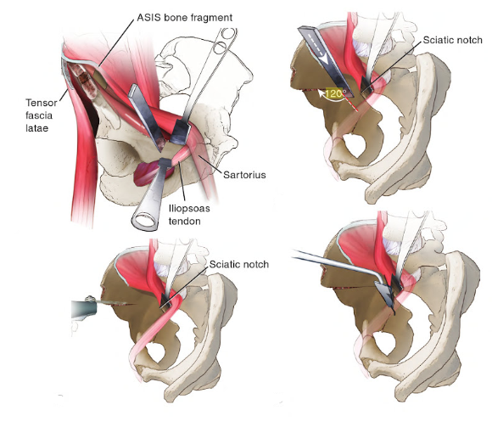
Project Relevance
ASSE 4311: Learning Outcomes Assessment III - SDP
Orthopedic operations:
  Metatarsal bunionectomy.
  Pelvis mobilization and correction.
  Knee implant surgery.

Slide 6
Design Constrains
ASSE 4311: Learning Outcomes Assessment III - SDP
Geometrical
Environmental & Safety
CONSTRAINS
Economic
Sustainability
Ethical
Manufacturability

Slide 7
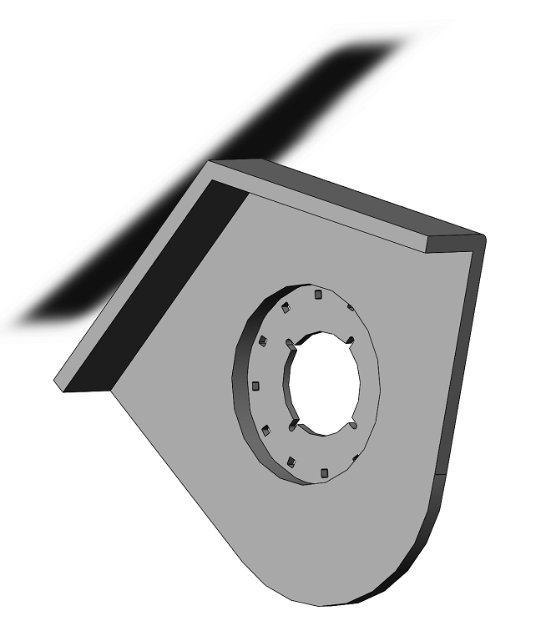
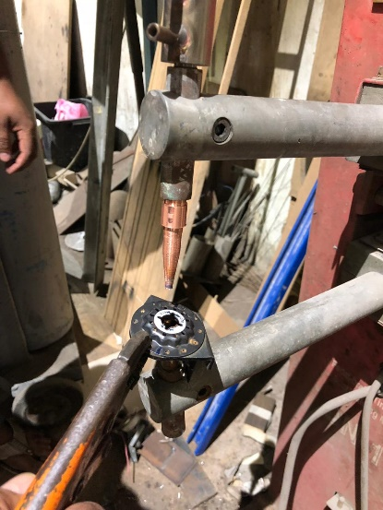
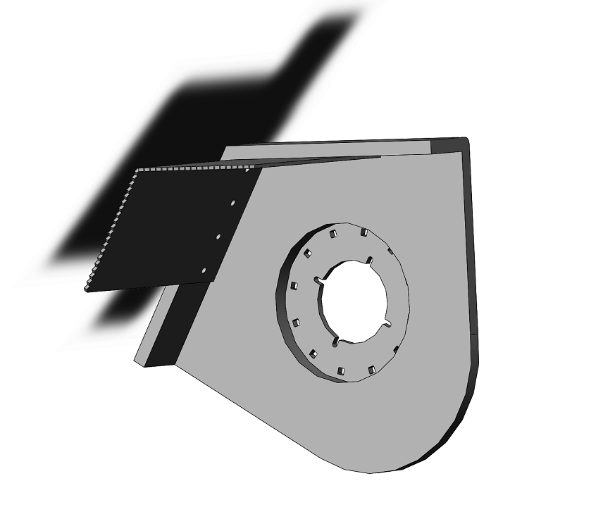
Engineering Standards
ASSE 4311: Learning Outcomes Assessment III - SDP
ASTM A36 Mild/Low Carbon Steel.
  Excellent welding properties.
  Suitable for grinding.
  Low resistance in bending.
Mechanical Properties | Metric
Tensile Strength, Ultimate | 400 - 550 MPa
Tensile Strength, Yield | 250 MPa
Elongation at Break (in 200 mm) | 20.0 %
Elongation at Break (in 50 mm) | 23.0 %
Modulus of Elasticity | 200 GPa
Bulk Modulus (typical for steel) | 140 GPa
Poissons Ratio | 0.260
Shear Modulus | 79.3 GPa

Slide 8
Engineering Standards
ASSE 4311: Learning Outcomes Assessment III - SDP
Components | Standard | Details
Screw | ANSI metric | Torx Oval-Head Screw 3x10
Bearing | SKF | Ball bearing - Deep grove
Bearing | SKF | Needle roller bearing

Slide 9
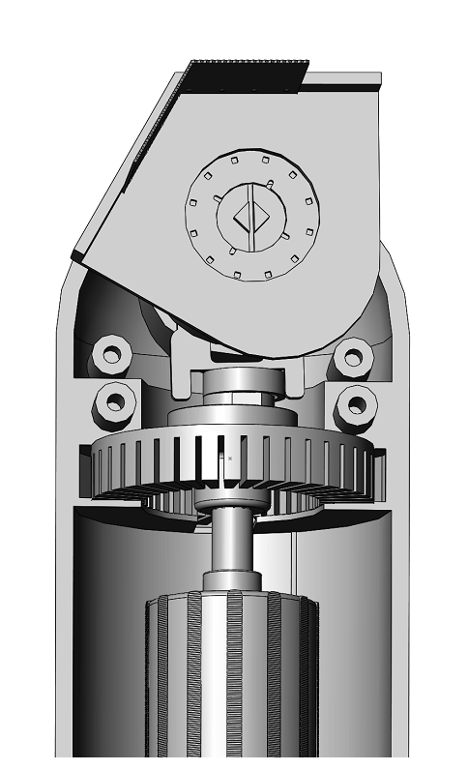
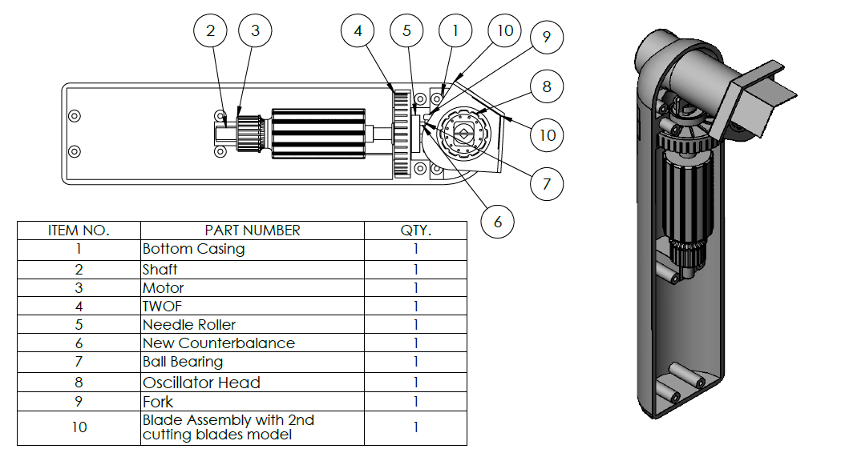
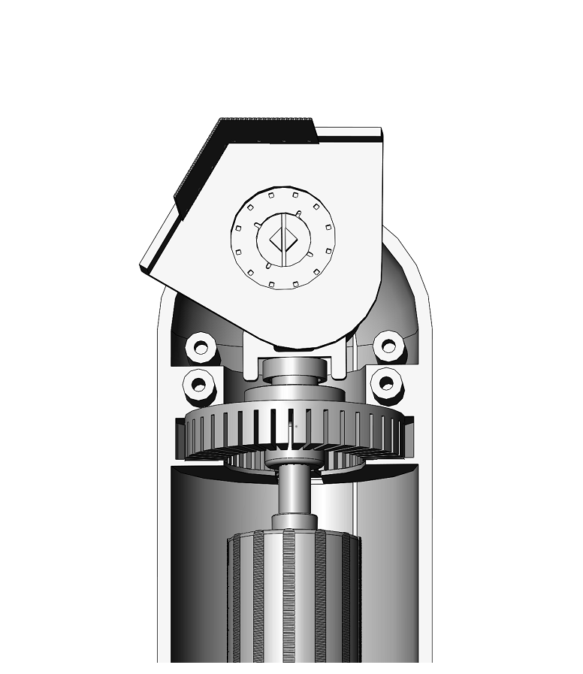
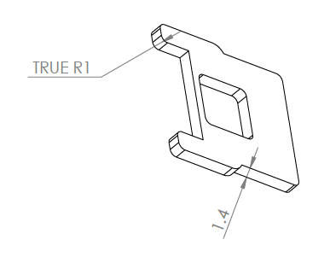
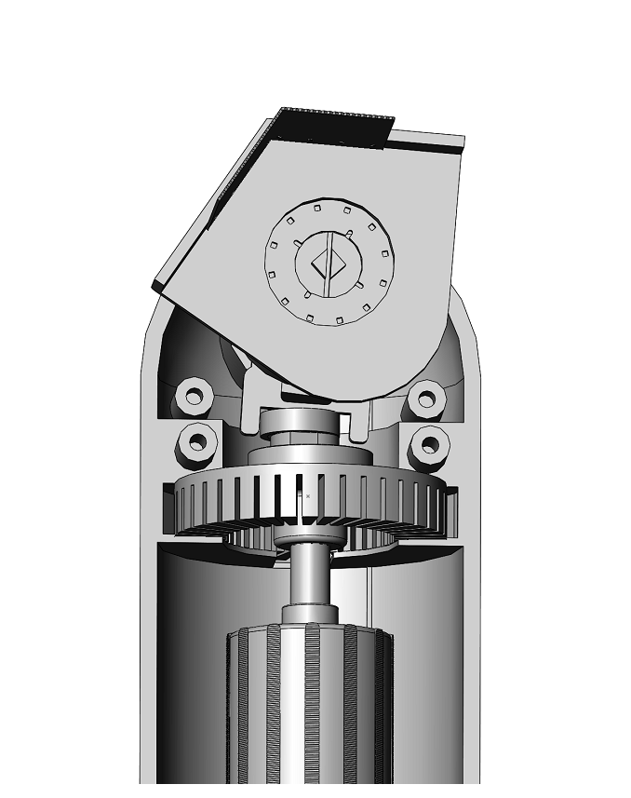

Conceptual Design “CAD Model”
ASSE 4311: Learning Outcomes Assessment III - SDP
$$θ=2.8$$

Slide 10
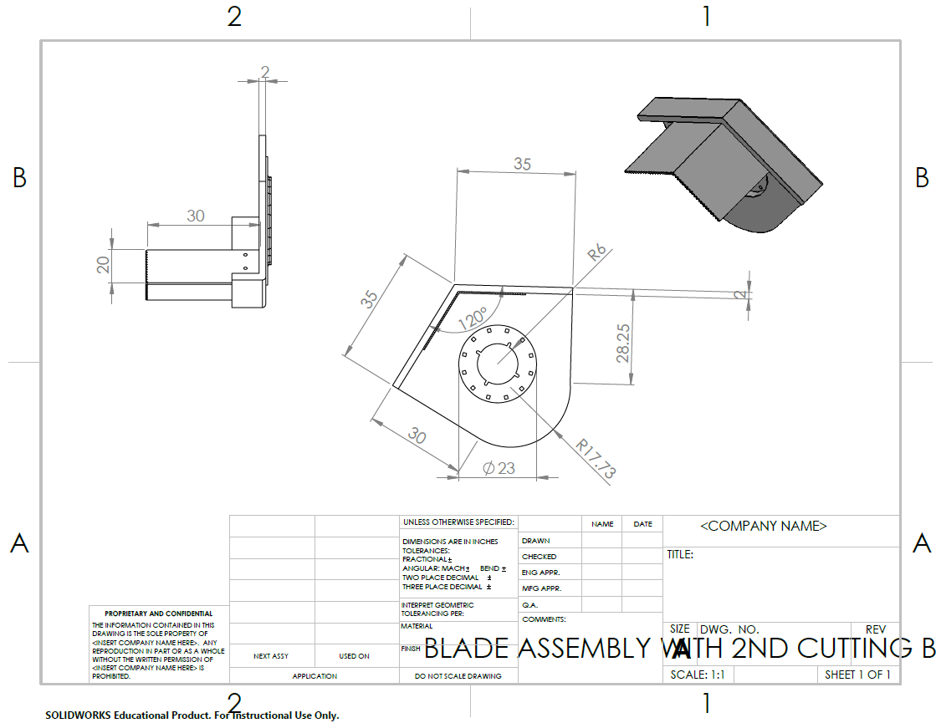
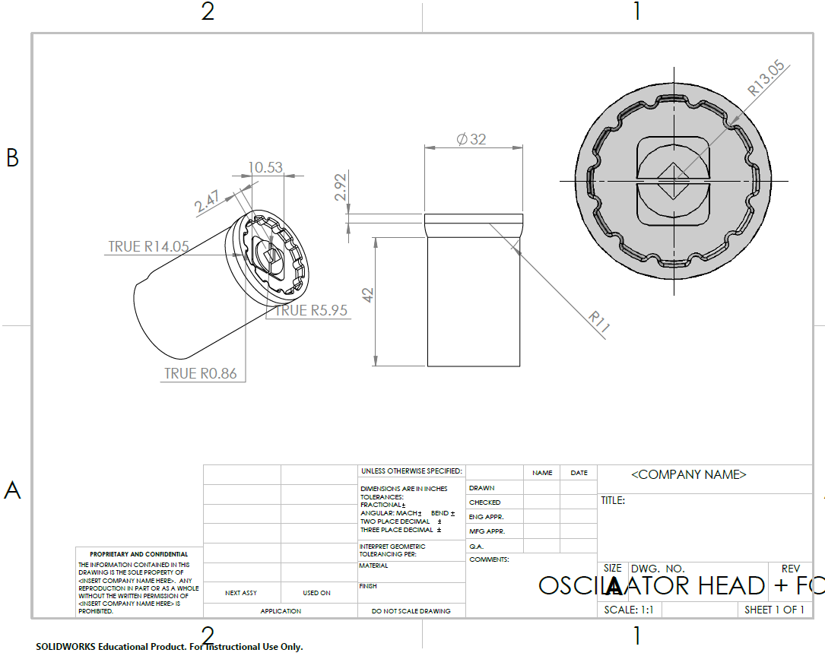
Conceptual Design “CAD Model”
ASSE 4311: Learning Outcomes Assessment III - SDP

Slide 11
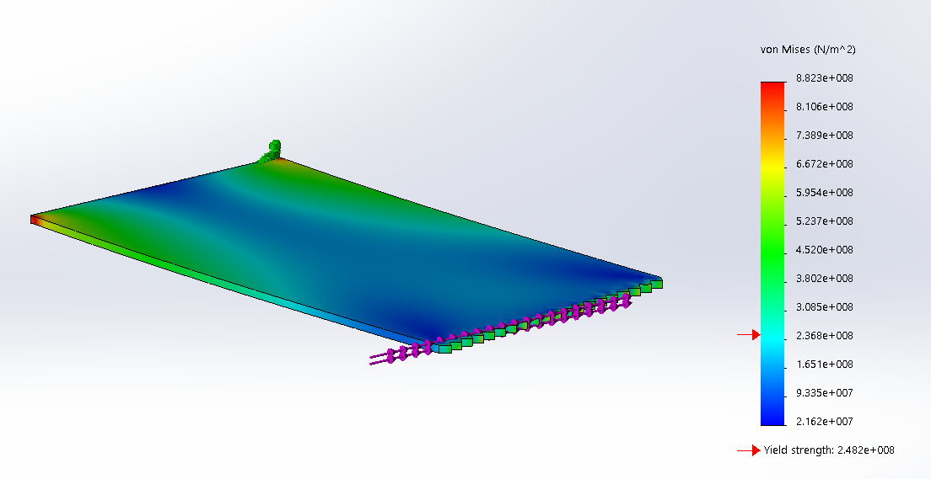
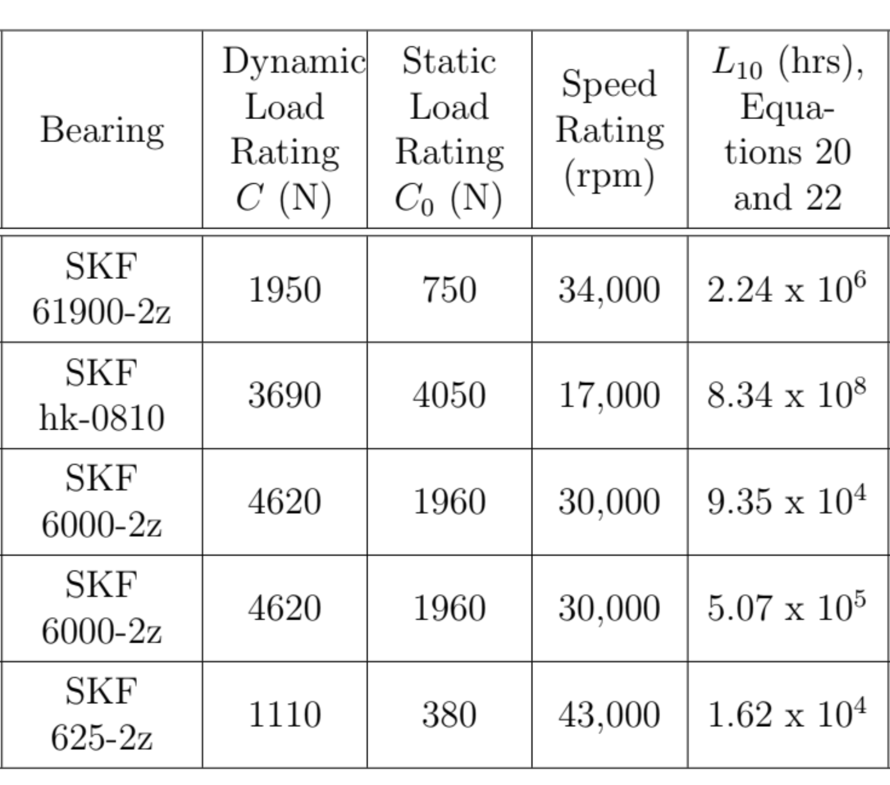
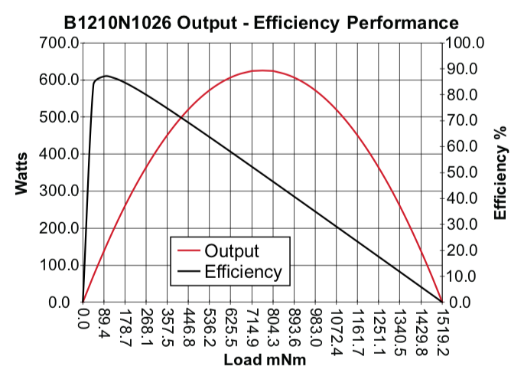


Conceptual Design “Equation and Parameters”
  $P=(F×r$) $× ω$
  $F=49.6N$
  $T=\frac{P}{ω}$ $=0.124 \text{Nm}$
  $I=\frac{b×h^{3}}{12}$ $=0.208 {mm}^{4}$
  $δ= \frac{F_{C}× L^{3}}{3×I×E}$ $=$ $0.01mm$
  $_{m}= \frac{P_{out}}{P_{in}}=52\%$
$L_{10}=\frac{90}{θ}$ ${\left(\frac{C}{F}\right)}^{a}$

Slide 12
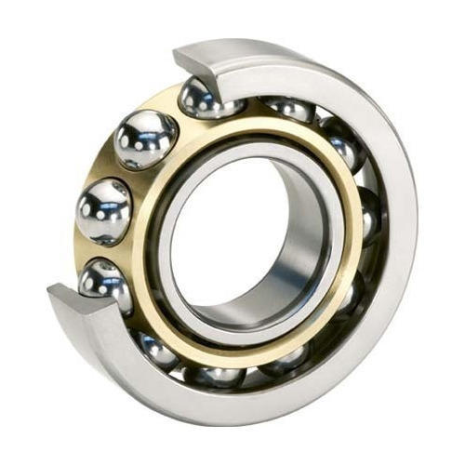
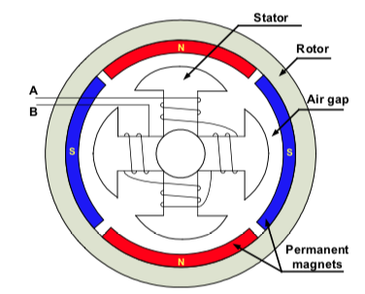
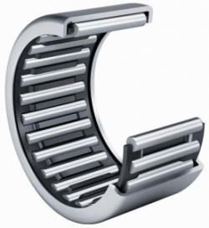
Conceptual Design “Configurations”
ASSE 4311: Learning Outcomes Assessment III - SDP
In line configuration.
Brushless DC motor.
Needle bearing.
Ball bearing.

Slide 13
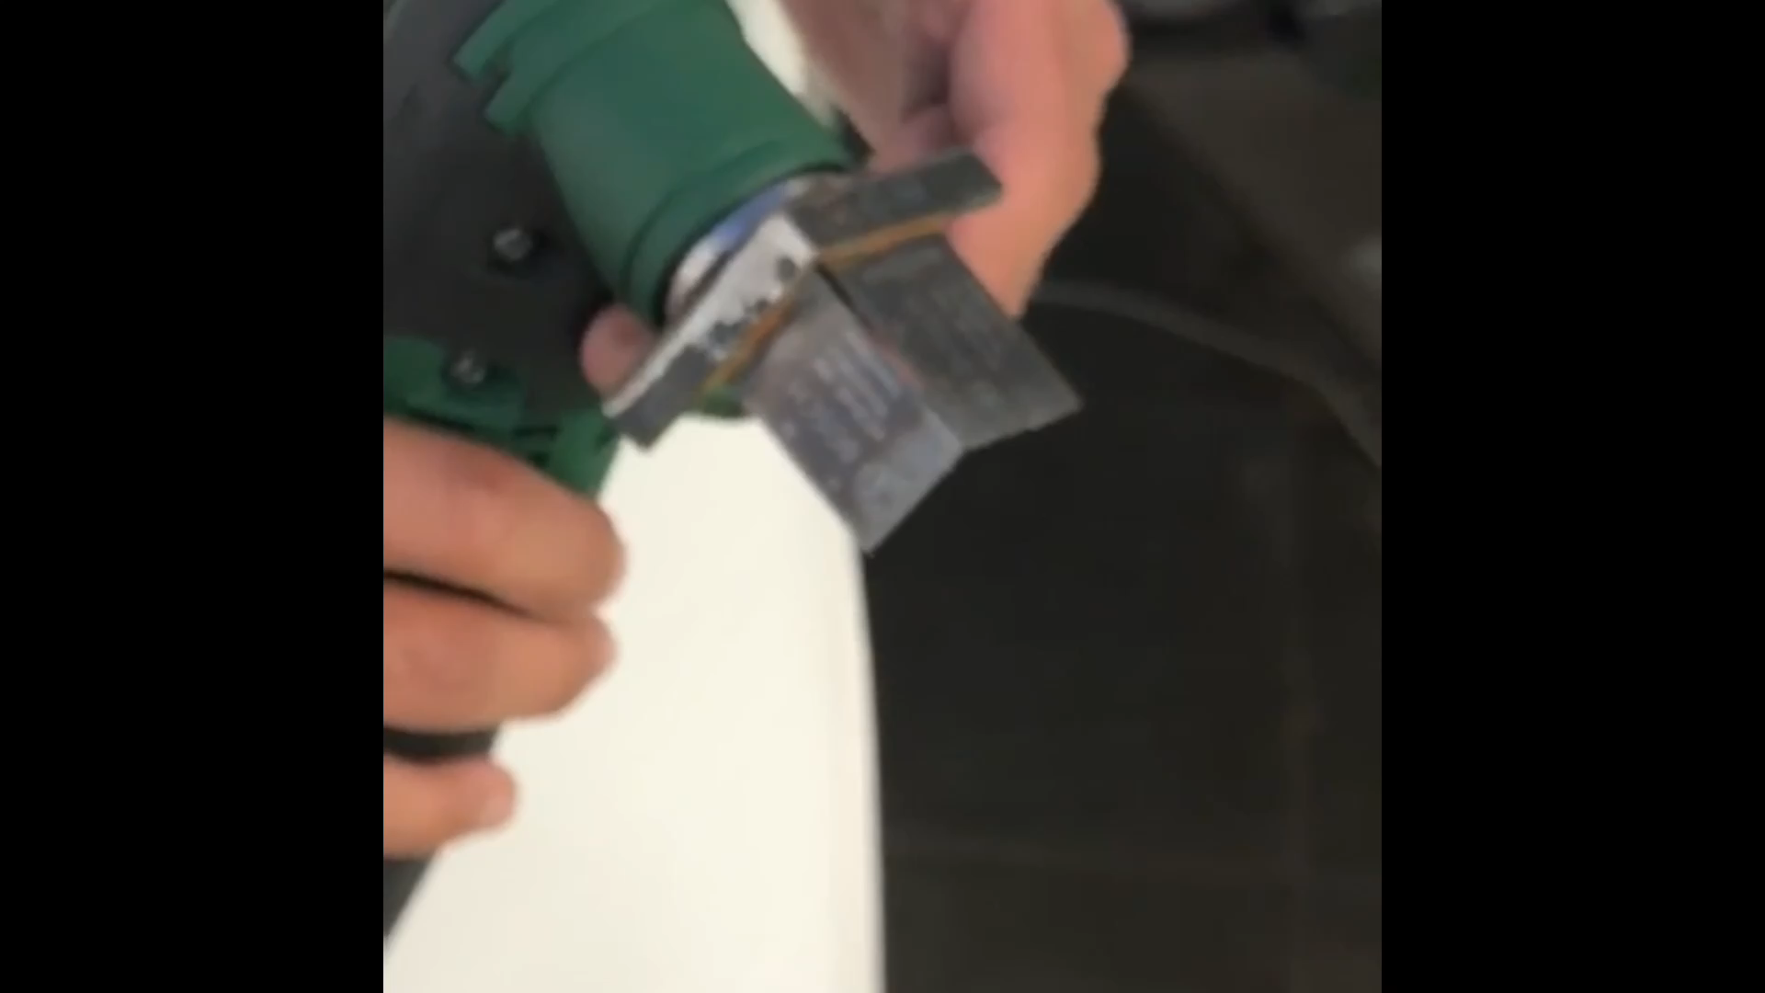
Testing & Results
ASSE 4311: Learning Outcomes Assessment III - SDP

Slide 14
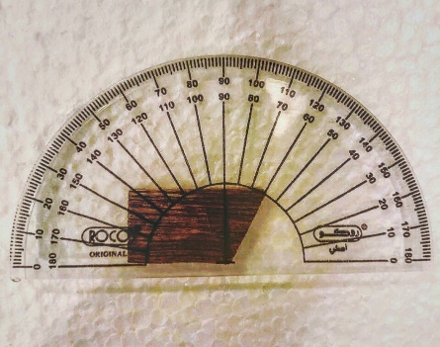
Testing & Results
ASSE 4311: Learning Outcomes Assessment III - SDP
Running a test on a piece of wood.
Angle of 120-degree.
Prove the concept of two blades cutting simultaneously with a precise defined angle.

Slide 15
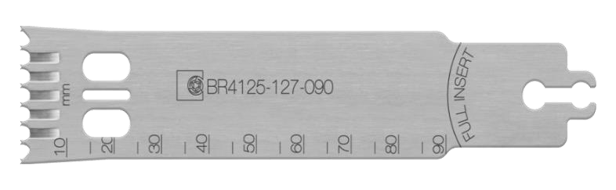
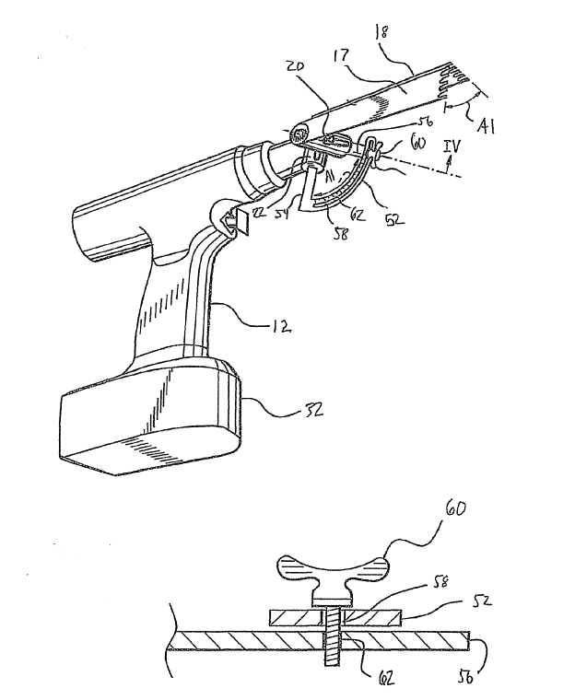
Conclusion and Future Recommendation
ASSE 4311: Learning Outcomes Assessment III - SDP
Replacing the motor.
Stryker seven blades.
Adding angle spacer

Slide 16
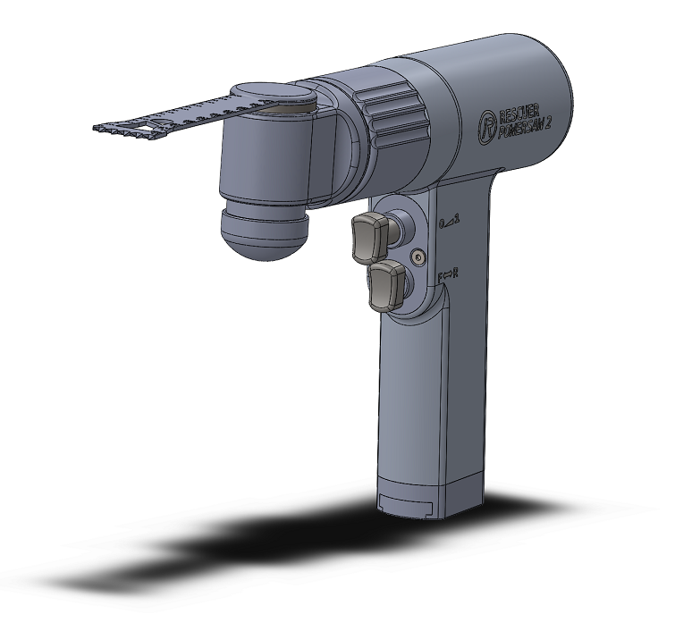
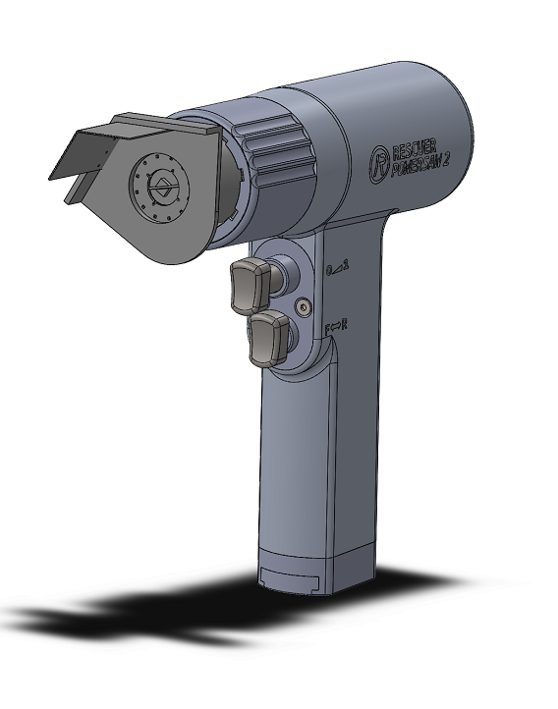
Conclusion and Future Recommendation
ASSE 4311: Learning Outcomes Assessment III - SDP

Slide 17
THANKS !!

